Slide 1
Annual People Survey
Great People. Great Place.
^{2011 Results - Uruguay}
Participation | 2011 | 2010
Uruguay | 73% | 95%
Mundial Group | 89% | 90%

Slide 2
SURVEY RESULTS DISCUSSION
WHY is it important?
WHAT are the results?
HOW will we improve?

Slide 3
ORGANIZATION & CULTURE STRATEGY
VISION We lead in the creation and delivery of innovative workforce solutions and services that enable our clients to win in the changing world of work
Revenue
Efficiency
Organization and Culture
Evolving our organization and culture requires attracting and retaining high quality people for the long term. It also requires creating an environment that promotes entrepreneurship, rewards high performance and motivates us to reach our full potential
Innovation
Thought Leadership
Great People
Great Place
I am
We are
Attract
Connect
Develop
Reward
Lead
Live
Execute
Attracted by challenging work and by making a difference
Connected to my colleagues and to the clients, candidates & communities that I support
Challenged and motivated to reach my fullest potential through the assignments, training and coaching I seek and receive
Accountable for my results, excited by differentiated rewards and inspired by a culture of recognition and celebration
Leaders in the changing world of work, leveraging our deep knowledge of human potential to provide our clients with innovative workforce solutions
Living our Values and Brand Attributes so we proudly create the ManpowerGroup Experience everyday
Executing against Vision, Credo and Strategies to drive industry star performance
Great People Processes Great Leadership
Great Results

Slide 4
Organization & Culture Strategy
GREAT PEOPLE
ATTRACT 57%
Attracted by challenging work and by making a difference
CONNECT 65%
Connected to my colleagues and to the clients, candidates & communities that I support
DEVELOP 45%
Challenged and motivated to reach my fullest potential through the assignments, training and coaching I seek and receive
REWARD 28%
Accountable for my results, excited by differentiated rewards and inspired by a culture of recognition and celebration
2011 OVERALL SCORE 55%
2010 OVERALL SCORE 58%

Slide 5
Organization & Culture Strategy
GREAT PLACE
LEAD 50%
Leaders in the changing world of work, leveraging our deep knowledge of human potential to provide our clients with innovative workforce solutions
LIVE 54%
Living our Values and Brand Attributes so we proudly create the ManpowerGroup Experience everyday
EXECUTE 42%
Executing against Vision, Credo and Strategies to drive industry star performance
2011 OVERALL SCORE 49%
2010 OVERALL SCORE 61%

Slide 6
2011 Strengths
What are the results?
Top 5 performing items
Survey Items | % Fav | Change*
I know what I need to do to deliver a great experience to our clients. | 93% | 5
Guidelines on ethical practice (Code of Conduct) have been made clear to me. | 90% | 14
Communications in my group are open and direct. | 88% | 13
I understand how I can contribute to meeting the needs of our clients. | 84% | 8
We treat our associates/contractors and candidates with respect. | 83% | 7
Most significant increases
Survey Items | % Fav | Change*
I stay updated on new developments that impact our business. | 57% | 20
My Manager has a good understanding of the external business environment in which we operate. | 70% | 16
Guidelines on ethical practice (Code of Conduct) have been made clear to me. | 90% | 14
Communications in my group are open and direct. | 88% | 13
The amount of work I am expected to do is reasonable. | 55% | 11
*As compared to 2010

Slide 7
2011 Opportunities
What are the results?
Bottom 5 performing items
Survey Items | % Fav | Change*
I have been fairly compensated (full package e.g. pay, benefits, incentives, etc.) for my performance in the last year. | 16% | -9
Leadership energizes and inspires people to be their best. | 17% | -25
Change is well managed in our organization. | 21% | -18
In my organization, when people say they will do something, they do it. | 26% | -16
I am encouraged to take risks so that we can be an innovative organization. | 27% | -21
Most significant decreases
Survey Items | % Fav | Change*
Leadership creates a learning environment and supports our development. | 29% | -30
Leadership aligns our vision and strategy with business objectives. | 40% | -30
Leadership is approachable and engaging. | 38% | -26
Leadership energizes and inspires people to be their best. | 17% | -25
We encourage new ideas and creative solutions. | 39% | -23
*As compared to 2010

Slide 8
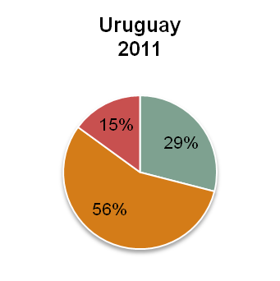
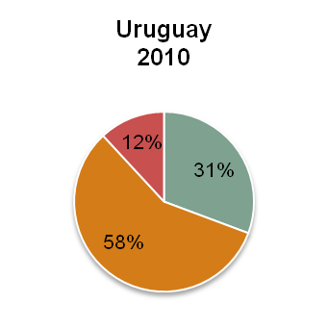
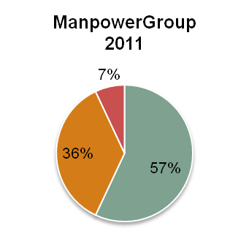
ENGAGEMENT LEVEL
ENGAGED
Employees answered positively to all four engagement items. (positive = strongly agree / tend to agree)
PARTIALLY ENGAGED
Employees answered positively to some but not all of the four engagement items.
NOT ENGAGED
Employees did not answer positively to any of the four engagement items. (not positive = tend to disagree / strongly disagree)

Slide 9
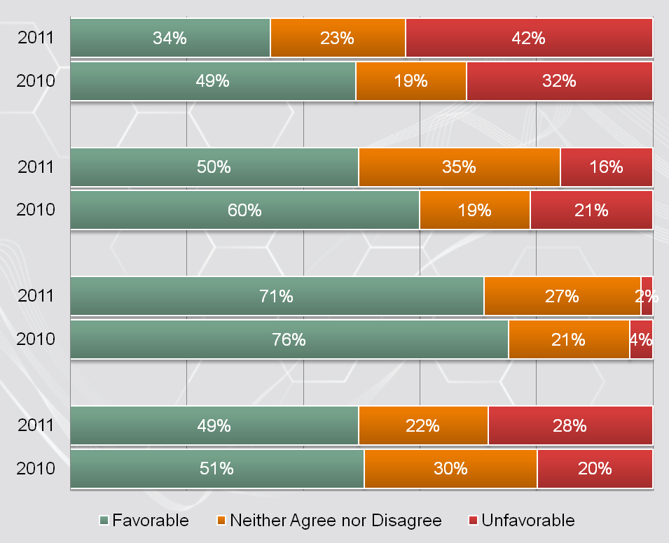
Individual Engagement Items
What are the results?
MOTIVATION
(I feel motivated in my current job.)
Job
SATISFACTION
(Overall I am satisfied with my present job.)
SERVICE ADVOCACY
(I speak highly of my organization's brand, services and solutions.)
Organization
EMPLOYER ADVOCACY
(I would recommend my organization to my friends and colleagues as a great place to work.)

Slide 10
2011 Drivers of Engagement
What are the results?
Red - take action
(less than 60% favorable)
Orange - consider for action (60%-70% favorable)
Green - keep up the good work (greater than 70% favorable)
2011 Drivers of Engagement | 2011 Fav % | Change* | 2010 Driver?
I believe there are opportunities in this organization to meet my career goals. | 32% | -11 | ✔
I trust the organization to treat me fairly. | 47% | -14 | ✔
I have been fairly compensated (full package e.g. pay, benefits, incentives, etc.) for my performance in the last year. | 16% | -9 | ✔
My Manager is good at motivating me. | 37% | -11 | ✔
We conduct our work with high ethical standards. | 62% | -1 | ✔
Leadership energizes and inspires people to be their best. | 17% | -25 | ✔
We treat our associates/contractors and candidates with respect. | 83% | 7
I have a clear understanding of what is expected of me at work. | 68% | -15
Our clients believe we are experts in our field. | 66% | -9
Our work processes are generally well organized and efficient. | 31% | -8
Highest Impact on Engagement
High Impact on Engagement
*As compared to 2010

Slide 11
Reflecting on our 2010 Action Plan
What are the results?
2010 Focus Areas | 2010 Actions | 2010 Fav % | 2011 Fav % | Change
Improved in 2011
Same or lower in 2011

Slide 12
Ideas for our 2011 Action Plan
How will we improve the results?

Slide 13
THANK YOU
for helping us be a great place to work!

Slide 14
APPENDIX (Additional details for managers)
Appendix

Slide 15
Engagement - Variation by Length of Service
Appendix
Percent of Sample
2011: | 25% | 13% | 33% | 10% | 19%
2010: | 25% | 17% | 27% | 10% | 20%

Slide 16
Engagement - Variation by Level
Appendix

Slide 17
Application to Retention
Appendix
Reported Intent to Stay
 | I plan to stay for at least 3 years | I plan to stay for 6 months - 3 years | I plan to stay for less than 6 months
Engaged | 20% | 12% | 2%
Partially Engaged | 5% | 39% | 22%
Not Engaged | N/A | N/A | N/A
Total | 24% | 51% | 24%
2011 Top 5 Drivers of Retention
 | 2011 Fav % | Change* | 2010 Driver?
I believe there are opportunities in this organization to meet my career goals. | 32% | -11 | ✔
I trust the organization to treat me fairly. | 47% | -14 | ✔
I have confidence in our Leadership's ability to deliver business success. | 41% | -22 | ✔
The amount of work I am expected to do is reasonable. | 55% | 11
We conduct our work with high ethical standards. | 62% | -1
Highest Impact on Retention
High Impact on Retention
Red - take action
(less than 60% favorable)
Orange - consider for action (60%-70% favorable)
Green - keep up the good work (greater than 70% favorable)
*As compared to 2010

Slide 18
Items Organized by Organization and Culture Strategy
Appendix

Slide 19
Great People - Attract
Appendix
Item # | Item | 2011 | 2010
9 | My Manager helps me understand how my job contributes to the success of the organization. | 62% | 67%
30 | The amount of work I am expected to do is reasonable. | 55% | 44%
31 | Our work processes are generally well organized and efficient. | 31% | 39%
32 | I have a clear understanding of what is expected of me at work. | 68% | 83%
33 | I have the equipment and/or materials I need to do my job well. | 73% | 66%
34 | I find my work challenging and fulfilling. | 45% | 50%
70 | I am proud of the work I do. | 65% | 74%

Slide 20
Great People - Connect
Appendix
Item # | Item | 2011 | 2010
2 | My Manager cares about me as a person. | 71% | 68%
5 | My Manager communicates relevant information on a timely basis. | 49% | 57%
6 | My Manager is approachable. | 81% | 72%
10 | My Manager encourages me to consider new ways of doing business and serving our clients. | 49% | 52%
21 | Communications in my group are open and direct. | 88% | 75%
22 | Communication is good across the teams or departments I work with. | 54% | 66%
23 | I receive the information I need to perform well in my job. | 66% | 56%
41 | My opinions are valued. | 58% | 63%
44 | Teamwork is encouraged in this organization. | 56% | 61%
46 | People collaborate across the organization to achieve common goals. | 38% | 54%
56 | I understand how I can contribute to meeting the needs of our clients. | 84% | 76%
57 | I receive the support I need to deliver what my clients require. | 60% | 56%
62 | We treat our associates/contractors and candidates with respect. | 83% | 76%

Slide 21
Great People - Develop
Appendix
Item # | Item | 2011 | 2010
1 | My Manager is good at motivating me. | 37% | 48%
8 | My Manager provides candid and timely feedback about my performance. | 54% | 49%
13 | My Manager coaches and mentors my development. | 43% | 60%
26 | I receive the development I need to do my job well. | 32% | 46%
27 | I have been assigned projects and/or responsibilities that contribute to my longer-term development. | 58% | 66%
28 | I believe there are opportunities in this organization to meet my career goals. | 32% | 43%
29 | I stay updated on new developments that impact our business. | 57% | 37%

Slide 22
Great People - Reward
Appendix
Item # | Item | 2011 | 2010
24 | I have been fairly compensated (full package e.g. pay, benefits, incentives, etc.) for my performance in the last year. | 16% | 25%
25 | I receive praise and recognition when I do a good job. | 30% | 49%
53 | We celebrate our successes. | 36% | 56%

Slide 23
Great Place - Lead
Appendix
Item # | Item | 2011 | 2010
11 | My Manager is a role model for our values. | 51% | 50%
15 | Leadership is a role model for our values. | 44% | 55%
19 | Leadership creates a learning environment and supports our development. | 29% | 59%
36 | Our organization values a diverse workforce. | 55% | 48%
38 | We encourage new ideas and creative solutions. | 39% | 62%
39 | We are able to attract great people to work here. | 39% | 30%
47 | People are treated with respect. | 77% | 74%
48 | I am encouraged to take risks so that we can be an innovative organization. | 27% | 48%
49 | I trust the organization to treat me fairly. | 47% | 61%
50 | We conduct our work with high ethical standards. | 62% | 63%
52 | As an organization we often think of new or different ways of doing things. | 38% | 58%
55 | We partner well with our clients to deliver innovative solutions. | 59% | 70%
61 | The organization's solutions and services meet the needs of a wide variety of clients. | 81% | 91%

Slide 24
Great Place - Live
Appendix
Item # | Item | 2011 | 2010
17 | Leadership energizes and inspires people to be their best. | 17% | 42%
18 | Leadership is approachable and engaging. | 38% | 64%
45 | People at this organization are approachable and engaging. | 48% | 67%
54 | In my organization people know they can raise ethical concerns without fear of retaliation. (NEW ITEM) | 47% | N/A
59 | We quickly respond to our clients' requests. | 78% | 85%
60 | Our clients believe we are experts in our field. | 66% | 75%
63 | We attract and retain better qualified associates/contractors and candidates than our competitors. | 45% | 54%
64 | I know what I need to do to deliver a great experience to our clients. | 93% | 88%
65 | We deliver a great experience to our candidates. | 65% | 74%
71 | I am proud to work for the organization. | 48% | 67%

Slide 25
Great Place - Execute
Appendix
Item # | Item | 2011 | 2010
3 | My Manager has a good understanding of the external business environment in which we operate. | 70% | 54%
14 | I have confidence in our Leadership's ability to deliver business success. | 41% | 63%
16 | Leadership aligns our vision and strategy with business objectives. | 40% | 70%
35 | Change is well managed in our organization. | 21% | 39%
37 | We anticipate changes in the market and make sure we are ready for them. | 32% | 49%
40 | We have a clear and compelling vision for the organization. | 46% | 52%
42 | We share internal best practices across the organization to improve our results. | 41% | 54%
43 | In my organization, when people say they will do something, they do it. | 26% | 42%
58 | We are committed to delivering high quality service. | 60% | 82%

